Slide 1

Seasonal Agriculture Performance Analysis
Mamidi Durga BhavanI
SIR C R REDDY COLLEGE OF ENGINEERING
AICTE STU ID : STU6a49e6f5614011783228149

Slide 2

PROBLEM STATEMENT
Agricultural activities are influenced by seasonal variations in environmental conditions, farming practices, resource availability and market conditions. As a result, agricultural performance may differ from one season to another. However, raw agricultural data does not clearly explain how agricultural performance changes across seasons or what patterns can be observed in different seasonal conditions. The problem is to analyze the given agricultural dataset and investigate seasonal differences in agricultural performance by identifying meaningful patterns, trends, relationships and variations within the available data.

Slide 3
Project Description The Seasonal Agriculture Performance Analysis project uses Data Analytics to examine how agricultural performance varies across different seasons, including Kharif , Rabi , and Zaid. The project analyzes agricultural data related to geographical regions, crops, environmental conditions, farming resources, crop yield, production, and economic performance.
The dataset is cleaned and analyzed using Python libraries such as Pandas, NumPy, Matplotlib, and Seaborn. The project compares important factors such as rainfall, temperature, soil conditions, water usage, fertilizer usage, crop yield, production, revenue, and profit across different seasons.
The analysis also identifies relationships, trends, regional variations, crop performance patterns, water efficiency, and disease and pest risks. The findings help identify meaningful seasonal differences and provide data-driven insights that can support better agricultural planning, efficient resource management, and improved farming decisions.

Slide 4
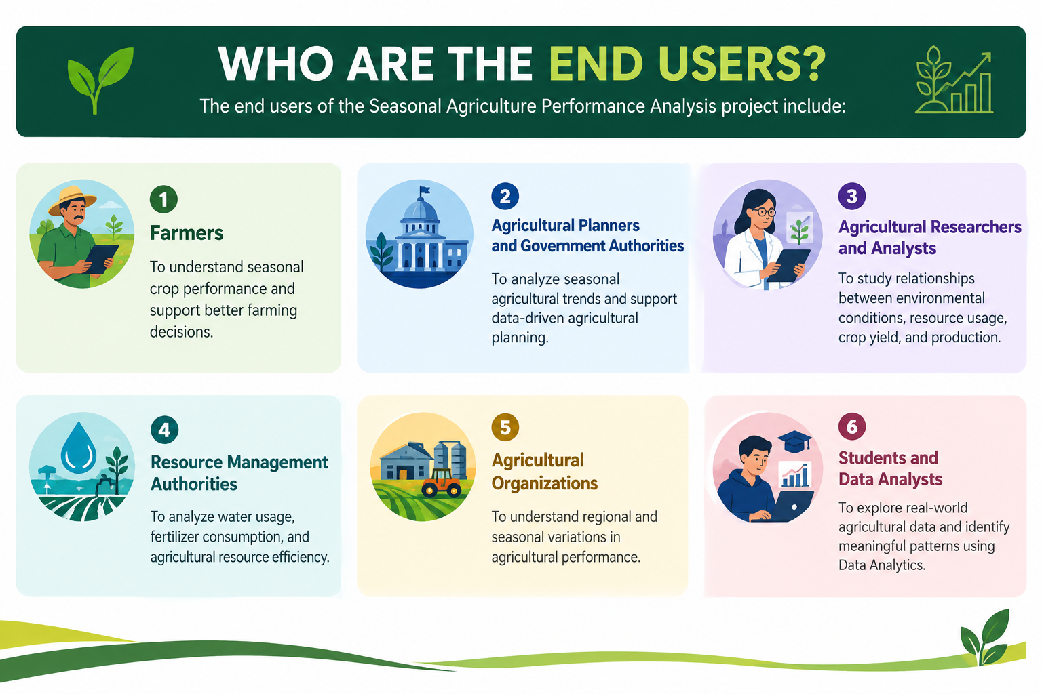


Slide 5
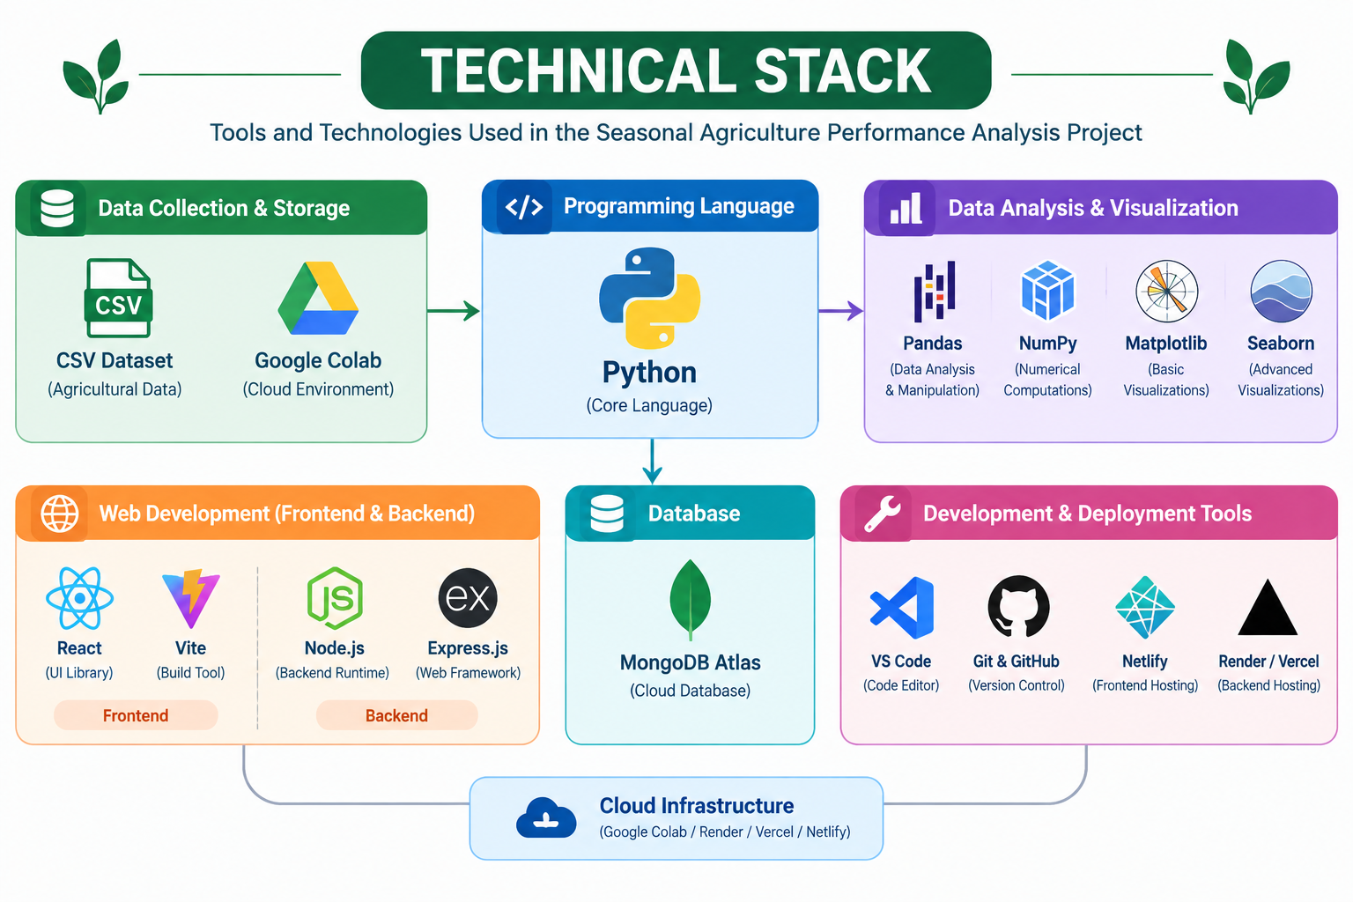


Slide 6
RESULT1: Dataset Cleaning & Preparation
 | 0
Farm_ID | 0
State | 0
District | 0
Crop | 0
Season | 0
Farm_Area_Hectares | 0
Rainfall_mm | 48
Avg_Temperature_C | 0
Humidity_pct | 0
Sunlight_Hours_Day | 0
Soil_pH | 0
Soil_Moisture_pct | 40
Nitrogen_kg_ha | 0
Phosphorus_kg_ha | 0
Potassium_kg_ha | 0
Irrigation_Method
The agricultural dataset was successfully cleaned and prepared for analysis. Missing values were handled using appropriate statistical techniques, and duplicate records were checked to ensure data quality. The cleaned dataset was then used for further seasonal, environmental, resource, and economic analysis.
Pesticide_Litre_ha | 0
Seed_Quality_Score | 0
Yield_Tonnes_Ha | 32
Production_Tonnes | 0
Market_Price_INR_Tonne | 0
Total_Cost_INR | 0
Revenue_INR | 0
Profit_INR | 0
Water_Used_m3 | 0
Water_Efficiency_t_per_1000m3 | 0
Disease_Pest_Risk_pct | 0

Slide 7
RESULT 2:Seasonal Performance Analysis
Agricultural performance was compared across Kharif, Rabi, and Zaid seasons using key performance indicators such as crop yield, production, revenue, profit, and water efficiency.
The analysis revealed noticeable differences in agricultural performance between seasons, demonstrating the influence of seasonal conditions on farming outcomes.
 | Yield_Tonnes_Ha | Production_Tonnes | Revenue_INR | Profit_INR | Water_Efficiency_t_per_1000m3
Kharif | 5.63 | 46.31 | 710719.06 | 178914.65 | 5.89
Rabi | 5.04 | 41.49 | 601526.05 | 87689.47 | 5.19
Zaid | 4.64 | 38.89 | 519171.90 | -24804.82 | 4.41

Slide 8
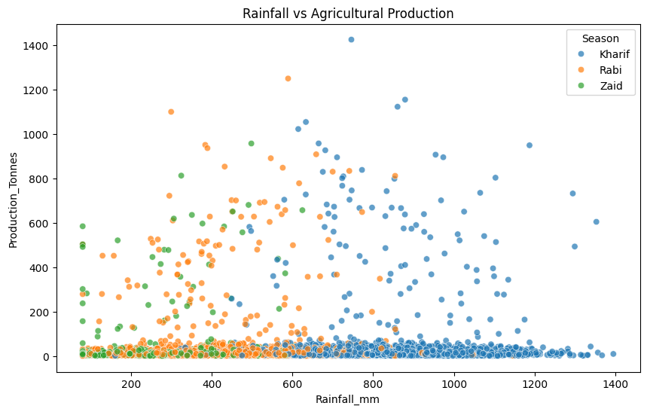
RESULT 3: Environmental & Resource Analysis 🌦️💧
Environmental conditions and agricultural resource usage were analyzed to understand their relationship with agricultural performance.Factors such as rainfall, temperature, water usage, fertilizer usage, and water efficiency were compared across different seasons

Slide 9
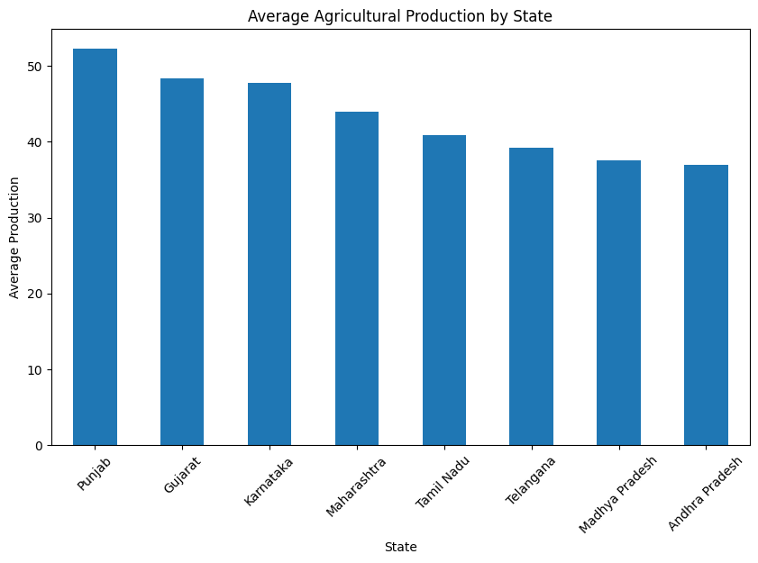
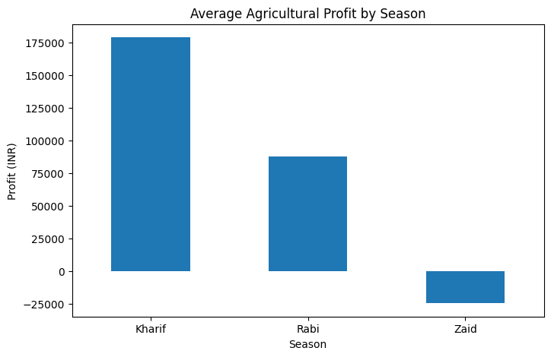
RESULT 4: Economic & Regional Analysis 💰📍
The economic performance of agricultural activities was analyzed using revenue, total cost, and profit. Agricultural performance was also compared across different states to identify regional variations.
The analysis helped identify differences in production and profitability across geographical regions and seasonal conditions.

Slide 10
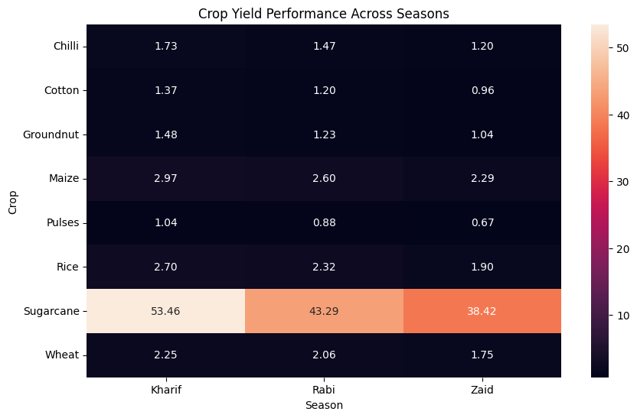
RESULT 5: Crop Performance & Final Insights 🌱📊
Crop performance was analyzed across different seasons to identify variations in yield and agricultural productivity.
The final analysis identified the best-performing season, crop, and state based on key agricultural performance indicators.

Slide 11
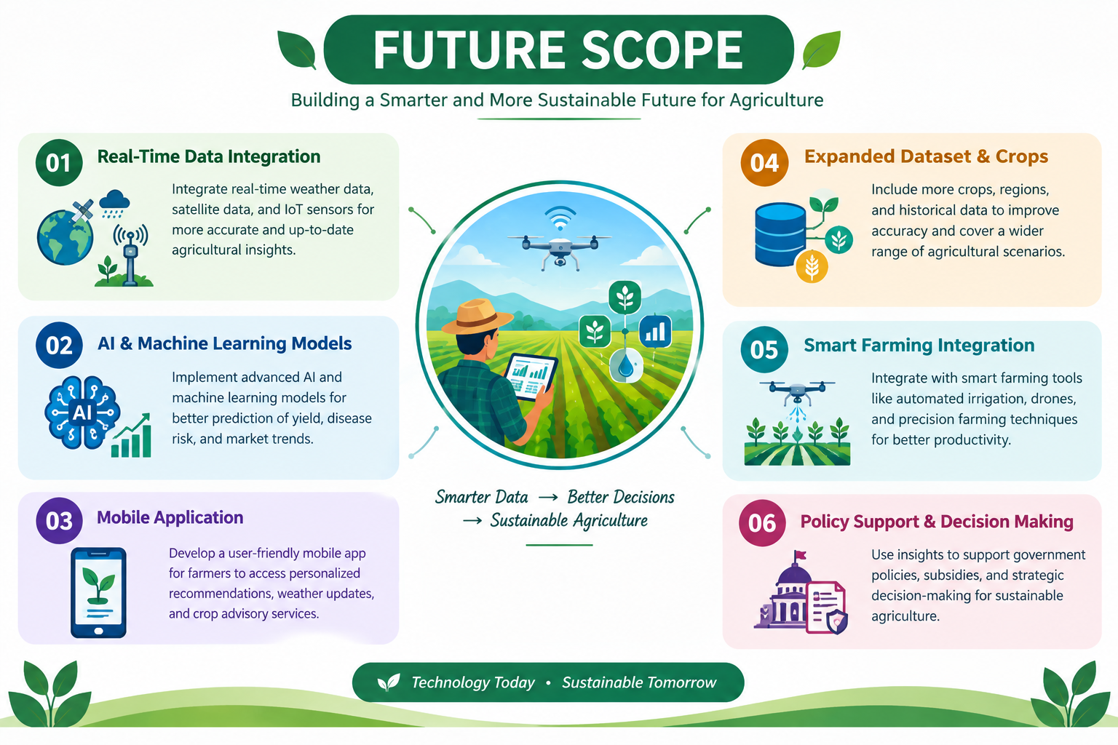

Slide 12
GitHub Link
https://github.com/mamididurgabhavani/Seasonal-Agriculture-Performance-Analysis

Slide 13
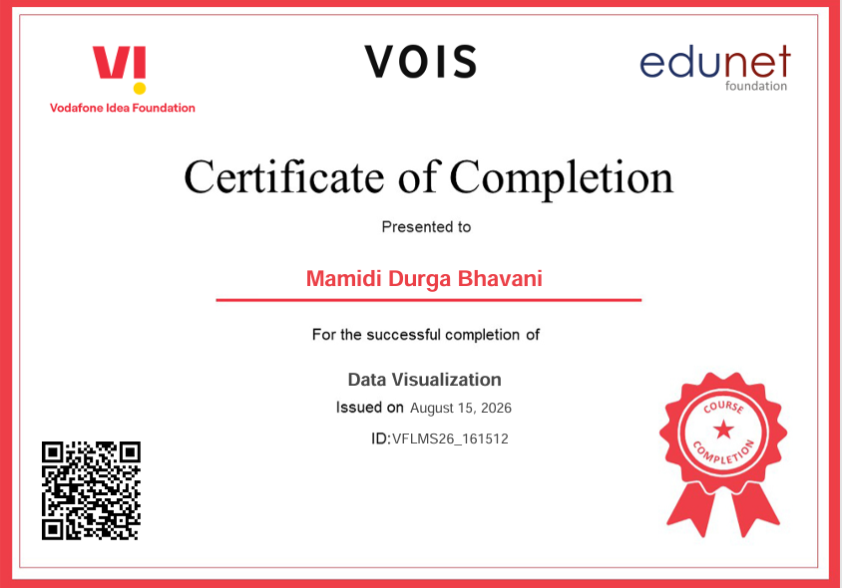
VOIS Course completion certificate - Course name- Data Visualization

Slide 14
Thank you
.
.

